Slide 1
A Language-Independent Approach for Tracking Source Code Lines

Slide 2
Problem
Given two different versions of a file, we want to track lines across versions.

Slide 3
Problem
Given two different versions of a file, we want to track lines across versions.
Old File
public int foo(int first, int sec){
//calculate total of two numbers
int tot = 0;
tot = first + sec;
return tot;
}
New File
public int foo(int first, int second){
int sum = 0;
//calculate total of two numbers
sum = first * second;
return sum;
}

Slide 4
Problem
Given two different versions of a file, we want to track lines across versions.
Old File
public int foo(int first, int sec){
//calculate total of two numbers
int tot = 0;
tot = first + sec;
return tot;
}
New File
public int foo(int first, int second){
int sum = 0;
//calculate total of two numbers
sum = first * second;
return sum;
}

Slide 5
Problem
Given two different versions of a file, we want to track lines across versions.
Old File
public int foo(int first, int sec){
//calculate total of two numbers
int tot = 0;
tot = first + sec;
return tot;
}
New File
public int foo(int first, int second){
int sum = 0;
//calculate total of two numbers
sum = first * second;
return sum;
}

Slide 6
Potential Applications
Locating bug-introducing changes.
Tracking code fragments across versions.
Managing annotation/tags during software evolution.
Merging file versions.
Code review.
Software evolution analysis.
Notes:
Bug-introducing changes are changes that introduce problems as indicated by later fixes.

Slide 7
Existing Solutions

Slide 8
Existing Solutions
Unix diff
  Cannot detect reordering of lines.
  A small change in line can affect the result.

Slide 9
Existing Solutions
Unix diff
  Cannot detect reordering of lines.
  A small change in line can affect the result.
Old File
public int foo(int first, int sec){
//calculate total of two numbers
int tot = 0;
tot = first + sec;
return tot;
}
New File
public int foo(int first, int second){
int sum = 0;
//calculate total of two numbers
sum = first * second;
return sum;
}

Slide 10
Existing Solutions
Unix diff
  Cannot detect reordering of lines.
  A small change in line can affect the result.
Old File
public int foo(int first, int sec){
//calculate total of two numbers
int tot = 0;
tot = first + sec;
return tot;
}
New File
public int foo(int first, int second){
int sum = 0;
//calculate total of two numbers
sum = first * second;
return sum;
}

Slide 11
Existing Solutions
ldiff (MSR 2007, ICSE 2009)
  Language-independent line matching technique
  Cannot detect line splitting

Slide 12
Existing Solutions
ldiff (MSR 2007, ICSE 2009)
  Language-independent line matching technique
  Cannot detect line splitting
New File
public int foo(
int first,
int second){
int sum = 0;
//calculate total of two numbers
sum = first * second;
return sum;
}
Old File
public int foo(int first, int sec){
//calculate total of two numbers
int tot =0;
tot = first + sec;
return tot;
}

Slide 13
Existing Solutions
ldiff (MSR 2007, ICSE 2009)
  Language-independent line matching technique
  Cannot detect line splitting
New File
public int foo(
int first,
int second){
int sum = 0;
//calculate total of two numbers
sum = first * second;
return sum;
}
Old File
public int foo(int first, int sec){
//calculate total of two numbers
int tot =0 ;
tot = first + sec;
return tot;
}

Slide 14
Existing Solutions
W_BESTI_LINE
( Recommended by Reiss, ICSE 2008)
  Language-independent approach
  Uses a combination of context and content similarity
  Tracking all lines of a file is expensive
  Cannot detect line splitting

Slide 15
Existing Solutions
SDiff (SCAM 2011)
  Better than other known techniques.
  Language-dependent technique.
  Cannot be applied to arbitrary text files.

Slide 16
Existing Solutions
SDiff (SCAM 2011)
  Better than other known techniques.
  Does not work with arbitrary text files.
Old File
public int foo(int first, int sec){
//calculate total of two numbers
int tot = 0;
tot = first + sec;
return tot;
}
New File
public int foo(int first, int second){
int sum = 0;
//calculate total of two numbers
sum = first * second;
return sum;
}

Slide 17
Motivation
What If
Language-Independent
Less Prone to Change
Detect Line Splitting
What
If ?

Slide 18
Our Contribution: LHDiff
A language-independent hybrid line mapping technique.

Slide 19
Our Contribution: LHDiff
A language-independent hybrid line mapping technique.
Step-1
Preprocessing
Step-5
Step-4
Step-3
Step-2
Detect Line Splits
Resolve Conflicts
Generate Candidate List
Detect Unchanged Lines
Notes:
The algorithm operates in five different steps. We will briefly describe each steps in the next slides

Slide 20
Step 1 : PREPROCESSING
Each line of a source file is normalized
Notes:
Many changes are only cosmetic in nature. They do not change the behavior of source code. In this step we normalize each source code lines to remove some of those differences.

Slide 21
Step 1 : PREPROCESSING
Each line of a source file is normalized
A Java Source File
public void fileReader(String path){
FileReader fr = new FileReader(path);
LineReader lr = new LineReader(fr);
String line = null;
while(line = lr.readLine()){
System.out.println(“line”)
}
}
Notes:
Lets take a look on an example. Here is a Java source file.

Slide 22
Step 1 : PREPROCESSING
Each line of a source file is normalized
A Java Source File
public void fileReader(String path){
FileReader fr = new FileReader(path);
LineReader lr = new LineReader(fr);
String line = null;
while(line = lr.readLine()){
System.out.println(“line”)
}
}
After Preprocessing
public void filereader(string path){
filereader fr = new filereader(path);
linereader lr = new linereader(fr);
string line = null;
while(line = lr.readline()){
system.out.println(“line”)
}
}
Notes:
Multiple white spaces are replaced by a single one.
Remove case differences.

Slide 23
Step-2: Detect Unchanged Lines
We now apply Unix diff algorithm.
Lines that are changed/added/deleted are reported as the sequence of added or deleted lined

Slide 24
Step-2: Detect Unchanged Lines
We now apply Unix diff algorithm.
Lines that are changed/added/deleted are reported as the sequence of added or deleted lined
New File
public void fileReader(String path){
//Change the reader
FileReader fr = new FileReader(path);
BufferedReader r = new BufferedReader(fr);
String line = null;
while(line = r.readLine()){
System.out.println(“line: ”+line);
} fr.close();
}
Old File
public void fileReader(String path){
FileReader fr = new FileReader(path);
LineReader r = new LineReader(fr);
String line = null;
while(line = lr.readLine()){
System.out.println(“line: ”+line) ;
}
}

Slide 25
Step-2: Detect Unchanged Lines
We now apply Unix diff algorithm.
Lines that are changed/added/deleted are reported as the sequence of added or deleted lined
New File
public void fileReader(String path){
//Change the reader
FileReader fr = new FileReader(path);
BufferedReader r = new BufferedReader(fr);
String line = null;
while(line = r.readLine()){
System.out.println(“line: ”+line);
} fr.close();
}
Old File
public void fileReader(String path){
FileReader fr = new FileReader(path);
LineReader r = new LineReader(fr);
String line = null;
while(line = lr.readLine()){
System.out.println(“line: ”+line) ;
}
}

Slide 26
Step-2: Detect Unchanged Lines
We now apply diff algorithm.
Lines that are changed/added/deleted are reported as the sequence of added or deleted lined
New File
public void fileReader(String path){
//Change the reader
FileReader fr = new FileReader(path);
BufferedReader r = new BufferedReader(fr);
String line = null;
while(line = r.readLine()){
System.out.println(“line: ”+line);
} fr.close();
}
Old File
public void fileReader(String path){
FileReader fr = new FileReader(path);
LineReader r = new LineReader(fr);
String line = null;
while(line = lr.readLine()){
System.out.println(“line: ”+line) ;
}
}
Notes:
We store the list of deleted and added lines into two different lists. From now on,
we refer them as the left and right lists correspondingly.

Slide 27
Step-2: Detect Unchanged Lines
We now apply Unix diff algorithm.
Lines that are changed/added/deleted are reported as the sequence of added or deleted lined
Right List
public void fileReader(String path){
//Change the reader
FileReader fr = new FileReader(path);
BufferedReader r = new BufferedReader(fr);
String line = null;
while(line = r.readLine()){
System.out.println(“line: ”+line);
} fr.close();
}
Left List
public void fileReader(String path){
FileReader fr = new FileReader(path);
LineReader r = new LineReader(fr);
String line = null;
while(line = lr.readLine()){
System.out.println(“line: ”+line) ;
}
}
Notes:
We store the list of deleted and added lines into two different lists. From now on,
we refer them as the left and right lists correspondingly.

Slide 28
Step-3: Generate Candidate List
Our goal is to determine mapping between lines in the left and right list
Right List
//Change the reader
BufferedReader r = new BufferedReader(fr);
} fr.close();
Left List
LineReader r = new LineReader(fr);
}
Notes:
Now we need to map lines in the left and right list.

Slide 29
Step-3: Generate Candidate List
Our goal is to determine mapping between lines in the left and right list
Oh, Its simple.
Use Content and Contextual Similarity
Just like W_BESTI_LINE does, Isn’t it?
Notes:
Now we need to map lines in the left and right list.

Slide 30
Step-3 Continue
A File
public int foo(int first, int sec){
//calculate total of two numbers
int tot = 0;
tot = first + sec;
return tot;
}
Consider this line

Slide 31
Step-3 Continue
A File
public int foo(int first, int sec){
//calculate total of two numbers
int tot = 0;
tot = first + sec;
return tot;
}
Content
Line itself
tot = first + sec;

Slide 32
Step-3 Continue
A File
public int foo(int first, int sec){
//calculate total of two numbers
int tot = 0;
tot = first + sec;
return tot;
}
public int foo(int first, int sec){
//calculate total of two numbers
int tot = 0;
Context
Consists of top and
bottom 4 lines
Content
Line itself
tot = first + sec;
return tot;
}

Slide 33
Step-3 CONTINUE
Right List
//Change the reader
BufferedReader r = new BufferedReader(fr);
} fr.close();
Left List
LineReader r = new LineReader(fr);
}
Notes:
Now we need to map lines in the left and right list.

Slide 34
Step-3 Continue
Right List
//Change the reader
BufferedReader r = new BufferedReader(fr);
} fr.close();
Left List
LineReader r = new LineReader(fr);
}
Determine content and context similarity between all pairs of lines.
  Content Similarity = Levenshtein Distance
  Context Similarity = Cosine Similarity
Calculate Combined Similarity Score:
Combined Sim. Score = 0.6 * Content Sim. + 0.4* Context Sim
Map lines that gives highest similarity score and exceed a predefined threshold value.
Notes:
Now we need to map lines in the left and right list.

Slide 35


Step-3 Continue
Calculating similarity between all pairs of lines?
It will take a long time
Particularly for Levenshtein distance
Right but what else we can do?
Notes:
Now we need to map lines in the left and right list.

Slide 36
Step-3 Continue
Calculating similarity between all pairs of lines?
It will take a long time
Particularly for Levenshtein distance
Right but what else we can do?
We use Simhash to solve the issue
Notes:
Now we need to map lines in the left and right list.

Slide 37
Step-3 CONTINUE
We generate simhash value for both context and content.
Determine hamming distance between two simhash values.
Determine combine similarity using hamming distance between all pairs of lines of left and right list.
For each line of left list, we take k lines from right list.
  We call this the candidate set.
k=15 is a good choice to work with.
Line A: if (num1>num2) | 10001001101101010000000000001011
Line B: if (first>second) | 11100000101001010110000011001011
Hamming Distance Between Line A & B: 9
Notes:
For two binary strings (a and b) Hamming distance is calculated by counting the number of 1 bits in a b (bitwise exclusive OR operation between a and b).
The smaller the hamming distance, the closer two two strings are.

Slide 38
Step-4 Resolve Conflict
Right List Line
BufferedReader r = new BufferedReader(fr);
Left List Line
LineReader r = new LineReader(fr);
Right List Line
//Change the reader

Slide 39
Step-4 Resolve Conflict
Right List Line
BufferedReader r = new BufferedReader(fr);
Left List Line
LineReader r = new LineReader(fr);
0.71
0.43
Right List Line
//Change the reader
For each line and its mapping candidates, we again determine the combine similarity Score.
Use textual similarity, not the similarity of simhash values.

Slide 40
Step-4 Resolve Conflict
Right List Line
BufferedReader r = new BufferedReader(fr);
Left List Line
LineReader r = new LineReader(fr);
0.71
✓
0.43
✕
Right List Line
//Change the reader
For each line and its mapping candidates, we again determine the combine similarity Score.
Use textual similarity, not the similarity of simhash values.
Take the match with highest similarity and also exceeds threshold value.

Slide 41
Step-5 DeTect LINE SPLIT
Old File
 | . . .
40. | protected Size2D arrangeRR (Range withRange, Range highRange, Graphics2D g2){
41. | Double w[]=new double[5];
42. | double h[]= new double[5];
 | . . .
New File
 | . . .
20. | protected Size2D arrangeRR
21. | (Range withRange, Range
22. | highRange, Graphics2D g2){
23. | Double w[]=new double[5];
24. | double h[]= new double[5];
 | . . .
Notes:
For each unmapped line of the new ﬁle, we repeatedly concatenate the line to the successive lines, one at a time, and determine normalized Levenshtein distance with another unmapped line in the old ﬁle until the similarity value starts to decrease.
Then, if the textual similarity between the concatenated lines and the left side line crosses a predeﬁne threshold value we map them

Slide 42
Step-5 DeTect LINE SPLIT
Old File
 | . . .
40. | protected Size2D arrangeRR (Range withRange, Range highRange, Graphics2D g2){
41. | Double w[]=new double[5];
42. | double h[]= new double[5];
 | . . .
New File
 | . . .
20. | protected Size2D arrangeRR
21. | (Range withRange, Range
22. | highRange, Graphics2D g2){
23. | Double w[]=new double[5];
24. | double h[]= new double[5];
 | . . .
LD(R₂₀₊₂₁,L₄₀)<LD(R₂₀,L₄₀)
LD(_{R20+21+22},L40)<LD(R₂₀₊₂₁,L₄₀)
LD(_{R20+21+22+23},L40)>LD(R₂₀₊₂₁₊₂₂,L₄₀)
Final Mapping: L₄₀ ->{R₂₀,R₂₁,R₂₂} ; LD=Normalized Levenshtein Distance
Similarity increases, so add another line
Similarity decreases, so stop
Notes:
For each unmapped line of the new ﬁle, we repeatedly concatenate the line to the successive lines, one at a time, and determine normalized Levenshtein distance with another unmapped line in the old ﬁle until the similarity value starts to decrease.
Then, if the textual similarity between the concatenated lines and the left side line crosses a predeﬁne threshold value we map them

Slide 43
Evaluation
We evaluate LHDiff using two different ways.
Using benchmarks
  where files are collected from real world applications and changes are made by real developers.
Using mutation-based testing
  Where files are collected from real world applications but changes made according to a taxonomy

Slide 44
Evaluating against benchmarks
Reiss Benchmark
1325 test cases
Eclipse Benchmark
232 test cases
More complex
NetBeans Benchmark
407 test cases
A balance between two
Simple changes
Incorrect mapping can be of three forms:
  Change
  Spurious
  Eliminate
Notes:
All these benchmarks are manually created.

Slide 45
Results (%Correct)
Techniques | Reiss Benchmark | Eclipse Benchmark | NetBeans Benchmark
W_BESTI_LINE | 96.7 | 52.6 | 61.9
LHDiff | 97.0 | 82.8 | 85.5
diff | 92.5 | 41.0 | 48.4
ldiff | 96.4 | 72.4 | 81.3
SDiff | 87.0 | 74.1 | 75.4
Git | 92.5 | 45.3 | 53.7

Slide 46
Can Tokenization Improve performance ?
Tokenization is the process of converting a sequence of characters of a source file into a set of token
Before Tokenization
1. | int sum =0;
2. | int number =0 ;
3. | List<Integer> list = new LinkedList<Integer>();
4. | System.out.println("Hello");
After Tokenization
1. | num sum val op colon
2. | num number op val colon
3. | List list op new LinkedList colon
4. | out.println string colon

Slide 47
Can Tokenization Improve performance ?
Benchmark | LHDiff | Correct% | Change% | Spurious% | Eliminate%
Reiss | Non-tokenize | 96.98 | 42.50 | 0 | 57.50
 | Tokenize | 93.66 | 0 | 48.81 | 51.19
Eclipse | Non-tokenize | 82.76 | 22.50 | 20 | 57.50
 | Tokenize | 82.76 | 47.50 | 32.50 | 20
NetBeans | Non-tokenize | 85.50 | 18.64 | 13.56 | 67.80
 | Tokenize | 82.56 | 32.39 | 9.86 | 57.75

Slide 48
Mutation-based analysis
Select source files from NetBeans and iText system.
Mutate source files considering an editing taxonomy of source code.
We record the location of target lines in the original and mutated file.

Slide 49
Editing Taxonomy
Mutation-based analysis continue..
Name | Old File | New File
Line Split/Merge | else if (x == 0) | else if (x == 0)
Function Split/Merge | int sum( File file){ //Read numbers and store in a list … //Calculate sum of numbers … return sum; } | ArrayList readFile( File f){ //Read numbers and store in a list … return list;} Public sum(File file){ ArrayList list = readFile(file); //Calculate sum of numbers … return sum;}
Wrapping/unwrapping | while(br.readLine())! = null) | try{ while(br.readLine())! = null) }catch(Exception e){…}
Change in data structue | ArrayList list = new ArrayList | LinkeList list = new ArrayList();
Renaming | sum = sum+ list.get(i) | total = total + list.get(i)
Code Reordering | foo(num1, num2); boo(arrayList); | boo(arrayList); foo(num1, num2);

Slide 50
Results of Mutation-based Evaluation
Techniques | Change in Data Structure | Wrapping | Line Split | Function Split | Renaming | Reordering
W_BESTI_LINE | 18.8 | 86.7 | 4.3 | 93.4 | 17.9 | 82.7
LHDiff | 56.3 | 90 | 68.1 | 93.4 | 35 | 83.8
diff | 6.3 | 90 | 2.1 | 55.7 | 0 | 13.5
ldiff | 12.3 | 80 | 44.7 | 95.1 | 42.5 | 82.4
SDiff | 93.8 | 80 | 51.1 | 15 | 15 | 82.4
Git | 6.3 | 80 | 2.1 | 85.3 | 0 | 66.2

Slide 51
Project Goal

Slide 52
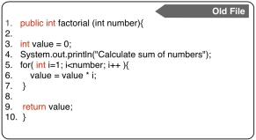
Project goal
1. Given two different versions of a file, print out which lines of the old file match to which line of the new file?
1-1
3-3
4-8
5-4
6-6
7-7
9-9
10-10

Slide 53
Project goal
2. Evaluate the tool using a new dataset (Contribute a new dataset and evaluate your tool using the new and old dataset)
The new dataset should contain the line tracking information 25 different files (You can contribute more ☺)

Slide 54
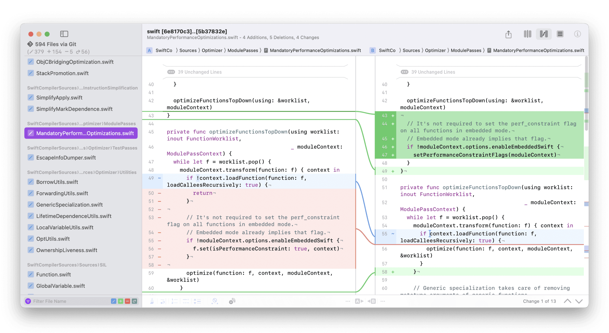
Project goal
3. How can you visualize file change information?
No implementation is needed. You need to share the GUIs that you plan to use.

Slide 55
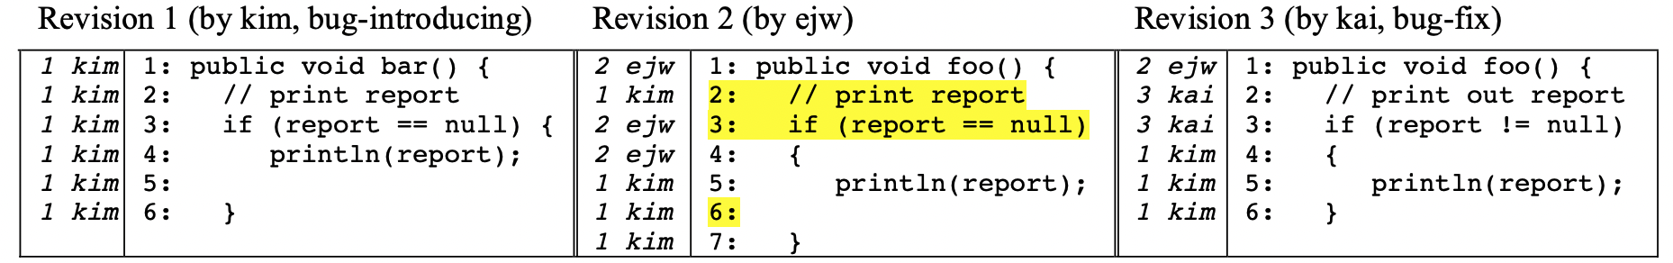
Project goal
3. Can you extend your tool to identify bug introducing changes from bug fix changes? (10% Bonus Mark)

Slide 56
Project goal
3. Can you extend your tool to identify bug introducing changes from bug fix changes? (10% Bonus Mark)
How to identify bug fix commit?
Check commit messages
1. Refactor authentication logic
2. Fix login error (#123)
3. Fix typo in user documentation closes #234
4. Update README to reflect new installation instructions

Slide 57
Thank YOU
Questions?

